Slide 1
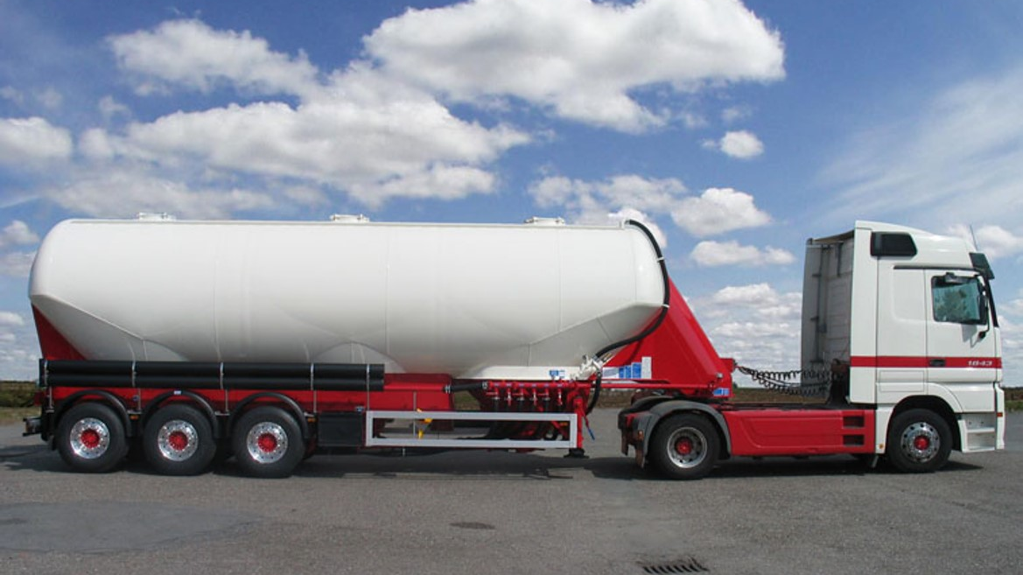
INTRODUCTION TO COFLO
INFORM Cement Optimization
Privacy Notice: This document and its content is the absolute property of INFORM GmbH and/or its subcontractors. The reproduction, distribution and utilization of this document as well as the communication of its contents to others without express authorization is prohibited. Offenders will be held liable for the payment of damages. All rights reserved in the event of the grant of a patent, utility model or design.

Slide 2
Agenda
Basic Approach of the Cement Optimization
Problem Description
Solution Method
Constraints
Fill Approach
Extension
Parameters

Slide 3
Basic Approach of the Cement Optimization

Slide 4
Problem Description
Input:
Set of trucks
Set of orders
Objective:
Find a sequence of orders for every truck, so that the sum of empty kilometers is minimal. Every order should be planned on exactly one truck.

Slide 5
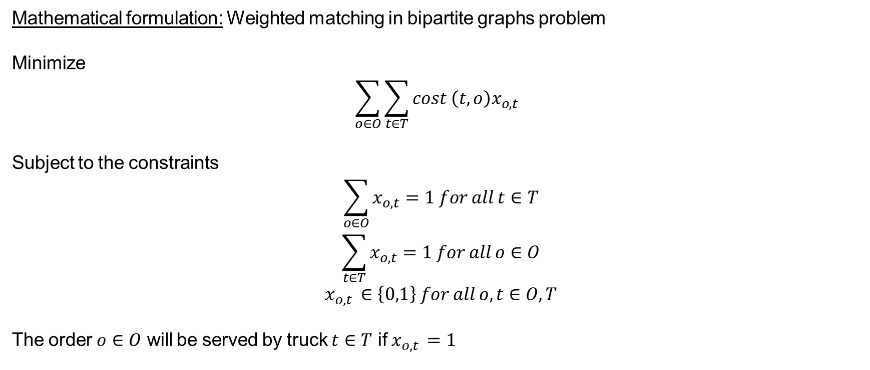
Solution Method
Mathematical formulation: Weighted matching in bipartite graphs problem
Minimize
$$\sum_{o∈O}{\sum_{t∈T}{cost \left(t,o\right)x_{o,t}} }$$
Subject to the constraints
$$\sum_{o∈O}{x_{o,t}=1 for all t∈T}$$
$$\sum_{t∈T}{x_{o,t}=1 for all o∈O}$$
$$x_{o,t }∈\left\{0,1\right\} for all o,t∈O,T$$
The order $o∈O$ will be served by truck $t∈T$ if $x_{o,t }=1$

Slide 6

Solution Method
Input: Set of Orders O, Set of Trucks T
While (O not empty)
Select a subset of orders S $⊂$ O
Solve core algorithm (S, T)
Remove S from O

Slide 7
Solution Method
Assume a sorting S of the all orders and a percentage value p is given the core algorithm of the Coflo works very roughly as follows:
Calc NumOrdersPerIterion = NumberOfTrucks * p
While S contains Orders
Solve a Linear Assignment Problem (LAP)¹ with the first NumOrdersPerIterion orders of S
Use the LAP result to plan the orders on the truck
Remove the orders from S
Return calculated schedule
The remaining questions are:
How do we calculate the sorting S?
How do we choose p?
1 = LAP is explained on the slide after next

Slide 8
Solution Method
Finding S and p works very roughly as follows:
Calc at least InitialNumOfOrderSequences*(default = 8) sorting's of all orders
Select a small subset of sorting's and run the core algorithm of the Coflo with the following percentages p₁, p₂, … p_{n}:
p₁= FirstPickPercentage*(5%)
p_{i} = p_{i-1} + StepPickPercentage*(5%)
p_{n} = LastPickPercentage*(150%)
Select a set P with NumPickPercentageToSelect*(5) percentages that created the best results on the small subset of sorting's
Calculate a schedule for every p in P and every sorting s in S
Select the NumSolutionsForShuffling*(2) best schedules
Shuffle the selected sorting's NumShufflingIterations*(150) times and calculate a new schedule with the core algorithm of the Coflo after every shuffling iteration
Return the best schedule that was found during the process

Slide 9
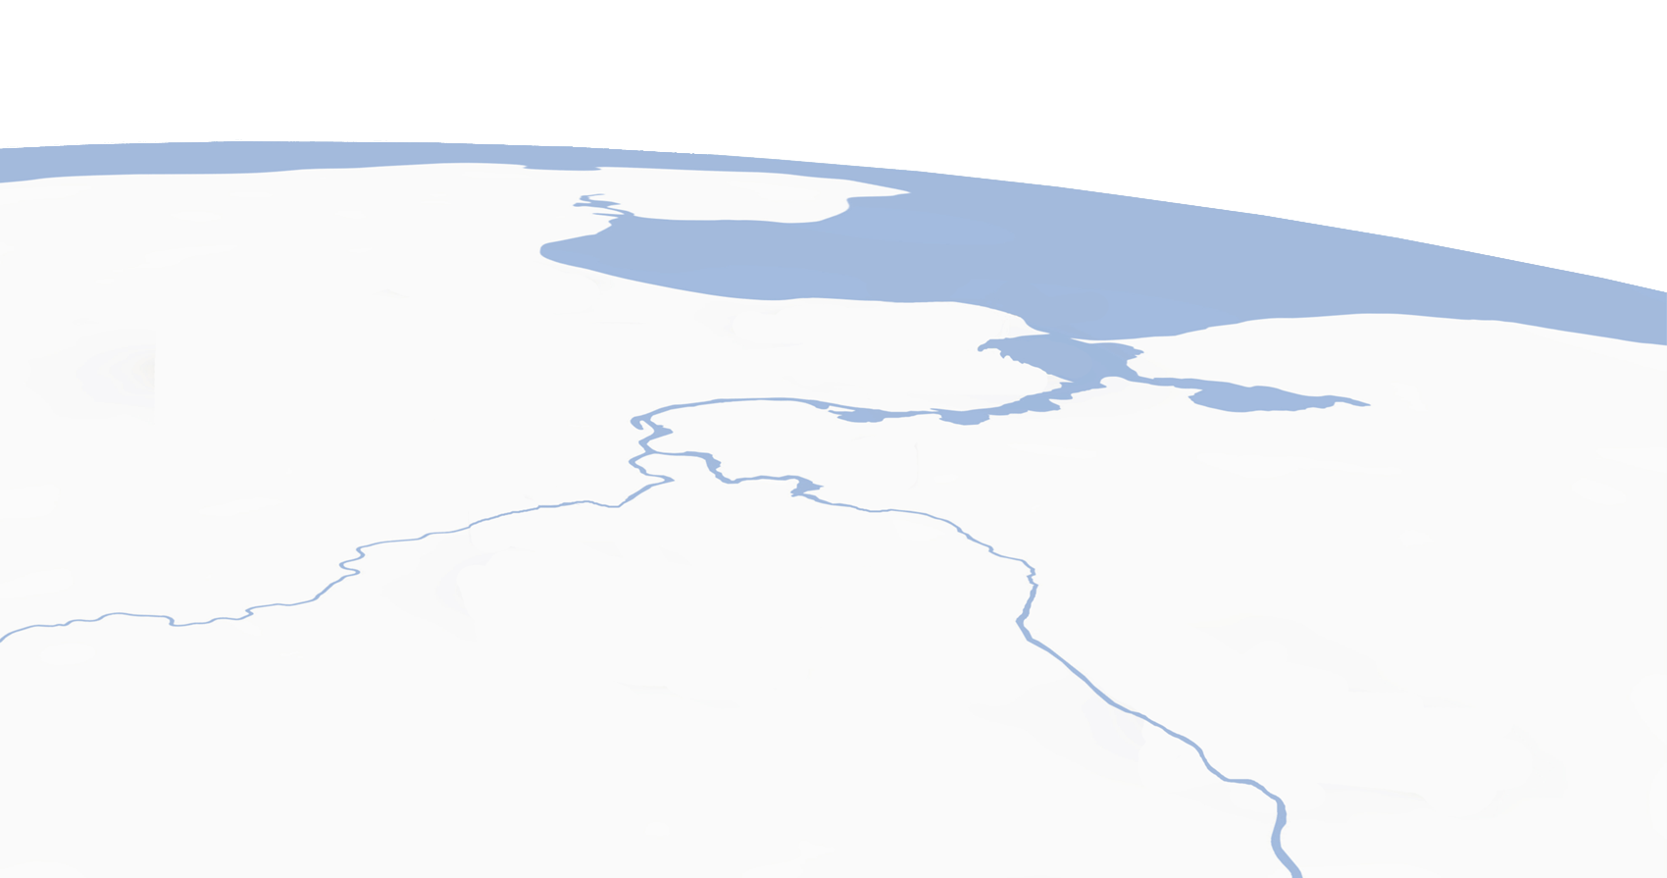
Problem Description
Order
Empty drive
Loaded drive
Order A
Order B
Truck A
Truck B
Truck C
Order C

Slide 10
Solution Method
Linear Assignment Problem:
Cost table
 |  | Truck A |  |  | Truck B |  |  | Truck C
Order A |  | 15 km |  |  | 40 km |  |  | 90 km
Order B |  | 95 km |  |  | 50 km |  |  | 20 km
Order C |  | 10 km |  |  | 20 km |  |  | 80 km

Slide 11
Solution Method
Linear Assignment Problem:
Cost table
 |  | Truck A |  |  | Truck B |  |  | Truck C
Order A |  | 15 km |  |  | 40 km |  |  | 90 km
Order B |  | 95 km |  |  | 50 km |  |  | 20 km
Order C |  | 10 km |  |  | 20 km |  |  | 80 km

Slide 12
Solution Method
Linear Assignment Problem:
Cost table
 |  | Truck A |  |  | Truck B |  |  | Truck C
Order A |  | 15 km |  |  | 40 km |  |  | 90 km
Order B |  | 95 km |  |  | 50 km |  |  | 20 km
Order C |  | 10 km |  |  | 20 km |  |  | 80 km

Slide 13
Solution Method
Linear Assignment Problem:
Cost table
 |  | Truck A |  |  | Truck B |  |  | Truck C
Order A |  | 15 km |  |  | 40 km |  |  | 90 km
Order B |  | 95 km |  |  | 50 km |  |  | 20 km
Order C |  | 10 km |  |  | 20 km |  |  | 80 km

Slide 14
Solution Method
Linear Assignment Problem:
Cost table
Note: The cost table must be recalculated after each iteration.
 |  | Truck A |  |  | Truck B |  |  | Truck C
Order A |  | 15 km |  |  | 40 km |  |  | 90 km
Order B |  | 95 km |  |  | 50 km |  |  | 20 km
Order C |  | 10 km |  |  | 20 km |  |  | 80 km

Slide 15
Full Approach
Output: Solution if no order was selected
Input
Heuristics for selection of an order subset
Schedule the result regarding all constraints
Calculation of cost table regarding all constraints
Core Algorithm

Slide 16
Constraints
Shifts of trucks Location opening hours Order time windows Orders deadlines Load durations Unload durations Preload orders Predrive orders Work duration of shifts Drive duration of shifts Roaming trucks Stationed trucks | Loaded parking Start drive threshold Order priorities Truck priorities Exclusions Properties Capacities Assigned Schedule Handling SAS handling FAS handling Remaining orders | Parameter control: Minimizing remaining orders Minimizing empty distance Minimizing delays Minimizing wasted worktime Prioritize short time windows

Slide 17
Extension Set Partitioning (SP)
Coflo generates a number of solutions = a set of independent vehicle routes, where an order can be served by at most one truck
Store all generated routes for each truck
Formulate a Mixed-Integer-Programming (MIP) Formulation and use a solver (SCIP or CBC) to generate combined solution given all routes generated

Slide 18

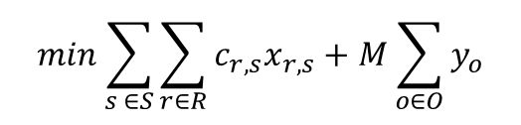

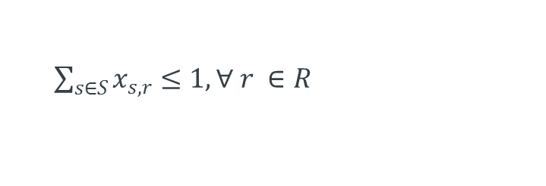
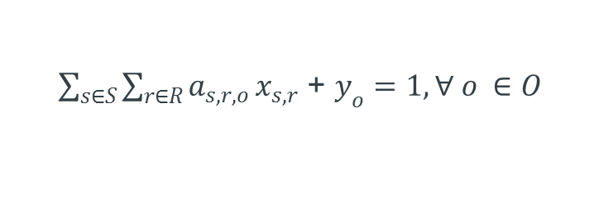
Extension
Parameters:
Decision variables:
$$c_{r, s}$$ | Cost of route performed by Resource r, in solution s
$$a_{s,r,o}$$ | Binary parameter, 1 if Order o is served in Route r in Solution s, 0 otherwise
$$x_{r, s} ∈\text{ \{0, 1\}}$$ | takes value 1 if route r, from solution s is in the final solution, 0 otherwise
$$y_{o} ∈\text{ \{0, 1\}}$$ | takes value 1 if order o is not served in any of the chosed routes
Routing costs
Costs for unserved orders
$$min\sum_{s ∈S}{\sum_{r∈R}{c_{r,s}x_{r,s}+M\sum_{o∈O}{y_{o}}}}$$
Subject to
$\sum_{s∈S}{\sum_{r∈R}{a_{s,r,o}}}x_{s,r}$ + $y_{o}=1, ∀ o ∈O$
Each order is served at most once
$\sum_{s∈S}{x_{s,r}}$ $≤1, ∀ r ∈R$
Each resource is used at most once
$$x_{s, r}∈\left\{0, 1\right\}, ∀ r ∈R, s ∈S$$
Variables’ domain
$$y_{o}∈\left\{0, 1\right\}, ∀ o ∈O$$

Slide 19
Extension
Solution 1
Solution 2
Solution 3
R1
R1
R1
R2
R2
R2
R3
R3
R3
R4
R4
R4
R5
R5
R5
Cost1 = 50
Cost2 = 60
Cost3 = 55
Solution 4
R1
R2
SP start
R3
R4
R5
Cost4 = 45

Slide 20
Parameters

Slide 21
Overview
Max. Empty Approach
Delay Cost Threshold
Order Priority Weight
Truck Priority Weight
Minimum Roaming Travel
Truck Treated As Idle
Preloads Aligned Right
Extra Time Ratio For Preload
Prefer Early Loading
Cost Function Weightings

Slide 22
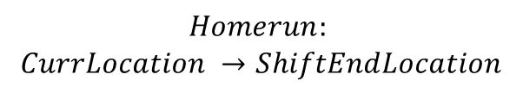
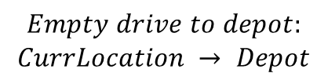
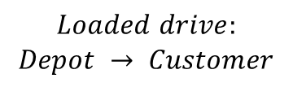

Maximum Empty Approach
The empty drive to the depot of the next order has to be smaller than:
$$max(Homerun,MaxEmptyApproach)$$
The parameter is only relevant for non roaming trucks and the default is 220 km.
$$Empty drive to depot:$$
$$CurrLocation → Depot$$
$$Loaded drive:$$
$$Depot → Customer$$
$$Homerun:$$
$$CurrLocation →ShiftEndLocation$$
Empty drive
Loaded drive

Slide 23
Delay Cost Threshold and Delay Cost Coefficient
The penalty of delay is quadratic up to the threshold, then the coefficient describes the slope of the linear cost function part.
Length of the delivery time window
3,600
Delay cost
0
7:00
8:00
9:00
10:00
Delivery time window
Deadline
Delay Cost Threshold

Slide 24
Order Priority Weight
The optimization will propose Order B for Truck 1 if the extra cost that are caused by the longer approach and homerun is less than the order priority weight. The default value is 100 seconds.
Order A on
Truck 1
6:00
7:00
8:00
Time
Order B on
Truck 1
6:00
7:00
8:00
Time
Empty Approach
Load – Drive – Unload
Homerun

Slide 25
Truck Priority Weight
The optimization will propose Order A for Truck 2 if the extra cost that are caused by the longer approach and homerun is less than the truck priority weight. The default is 100 seconds.
Order A on
Truck 1
6:00
7:00
8:00
Time
Order A on
Truck 2
6:00
7:00
8:00
Time
Empty Approach
Load – Drive – Unload
Homerun

Slide 26

Minimum Roaming Travel
A roaming truck stays at the facility if the following condition is met.
$$MinimumRoamingTravel > timeLeftInShift$$
The default is 3,600 seconds.
30 minutes left in shift
....
....
17:00
18:00
19:00
6:00
7:00
8:00
60 minutes left in shift
....
....
17:00
18:00
19:00
6:00
7:00
8:00
Empty Approach
Load – Drive – Unload
Predrive

Slide 27

Truck Treated As Idle
A Truck will be treated as idle by the optimizer if the following condition is met.
$$LastProposal − truckTreatedAsIdle < now$$
The default is 7,200 seconds.
Last proposal
now
0
17:00
18:00
19:00
Time
Truck Treated As Idle
Finished Work
Load – Drive – Unload
Predrive

Slide 28
Truck Treated As Idle
The cost benefit will start a 0 when the optimizer starts to handle the truck as idle and grows linear. The benefit will reach the maximal value when the truck is actually idle.
now
Last proposal
2,000
Prevent Idle Cost Benefit
0
17:00
18:00
19:00
Time
Truck Treated As Idle
Finished Work
Load – Drive – Unload
Predrive
Cost Benefit

Slide 29
Preloads Aligned Right
If the parameter is true the optimizer will shift every preload as far right as possible. The default is true.
....
6:00
11:00
16:00
6:00
11:00
Time
....
Time
6:00
11:00
16:00
6:00
11:00
Empty Approach
Load – Drive – Unload
Drive

Slide 30

Extra Time Ratio For Preload (ETRFP) and Extra Time For Preload (ETFP)
The optimization will propose a preload in case of shift end with drive to parking location only if the following condition is met.
$$duration\left(b\right)+duration\left(c\right)<\left[duration\left(e\right)+ETFP\right]∗ETRFP$$
Default ETRFP: 100%, Default ETFP: 600 seconds
Preload proposal
Standard proposal
a
d
c
b
e

Slide 31
Prefer Early Loading
The optimization prefers early loading for orders with long loaded travel by adding extra costs to proposals with late start load. The PotentialMaxExtraCost grow linear between MinDrivingTime and MaxDrivingTime from 0 to MaxExtraCost.
Assume the drive from depot to the customer for Order O takes 2 ½ h. That means the PotentialMaxExtraCost for this order is 1,500 seconds.
MinDrivingTime (Default: 7,200 seconds)
MaxDrivingTime (Default: 10,800 seconds)
3,000
PotentialMaxExtraCost (Default: 3,000 seconds)
0
Driving time
Depot → Customer
1h
2h
3h
4h
5h

Slide 32
Extra Time Ratio For Preload
The extra costs that are added grow linear from 0 to PotentialMaxExtraCost(O) between EarliestLoadStart(O) + MinExtraCostBackShift and EarliestLoadStart(O) + MaxExtraCostBackShift.
The defaults of MinExtraCostBackShift and MaxExtraCostBackShift are 3,600 and 10,800 seconds, respectively.
If the load starts at 19:00 this will cause extra costs of 500 seconds.
EarliestLoadStart(O) +
MinExtraCostBackShift
EarliestLoadStart(O) +
MaxExtraCostBackShift
1,500
PotentialMaxExtraCost(O)
0
18:00
19:00
20:00
21:00
22:00

Slide 33
Cost Function Weightings
The objective function is complex and it is not possible to explain it on a few slides. This is only a short wrap up of the elements of the objective function with two examples that are showing the costs for the order O₂.
WaitingTime
O
O
1
2
ShiftStart
EmptyApproach
ShiftEnd
ShiftStart
Load – Drive – Unload
Empty Approach
EmptyApproach
Default weight: 2.0
Working Time of the shift
WaitingTime
Default weight: 0.0

Slide 34
Cost Function Weightings
WastedPrevShiftTime
WastedPrevWorkTime
EmptyHomerun
O
1
O
2
ShiftStart
ShiftEnd
ShiftStart
ShiftEnd
ShiftStart
Homerun
WastedPrevWorkTime
Default weight: 0.0
Load – Drive – Unload
WastedPrevShiftTime
Default weight: 0.0
Working Time of the shift
EmptyHomerun
Default weight: 2.0

Slide 35
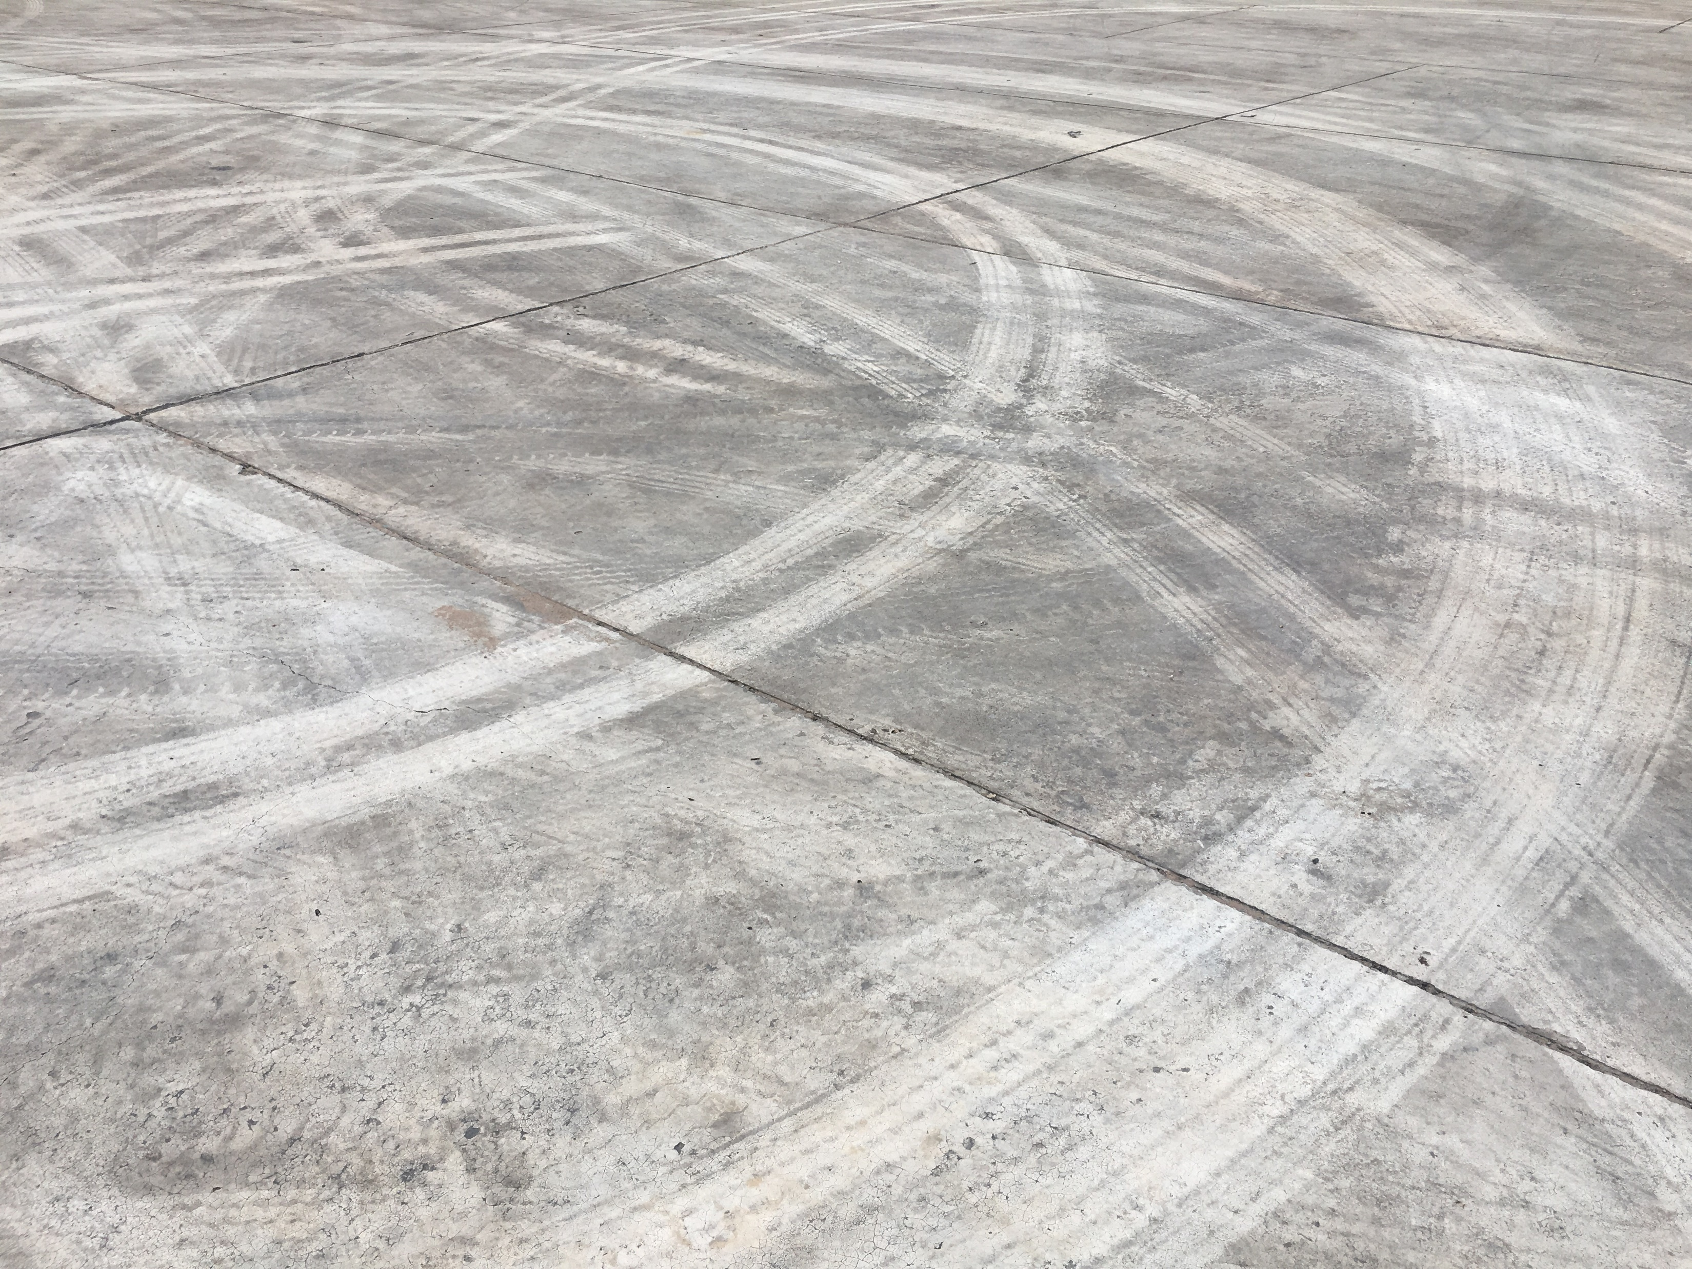
Q&A
Refer to proprietary notice on title page

